Slide 1

Applied Data Science Portfolio Milestone
by Jose Reyes

Slide 2
Applied Data Science – Learning Outcomes
Describe a broad overview of the major practice areas of data science.
Collect and organize data.
Identify patterns in data via visualization, statistical analysis, and data mining.
Develop alternative strategies based on the data.
Develop a plan of action to implement the business decisions derived from the analyses.
Demonstrate communication skills regarding data and its analysis for managers, IT professionals, programmers, statisticians, and other relevant professionals in their organization.
Synthesize the ethical dimensions of data science practice (e.g., privacy).

Slide 3
Courses and projects
IST 707 – Data Analytics
Understanding Flight Delays and Cancellations
IST 718 – Big Data Analytics
Predicting Covid-19 Related Deaths
IST 652 – Scripting for Data Analysis
Classifying Toxic Comments
IST 659 – Data Admin Concepts & Database Management
Building a Nuclear Cardiology Database

Slide 4
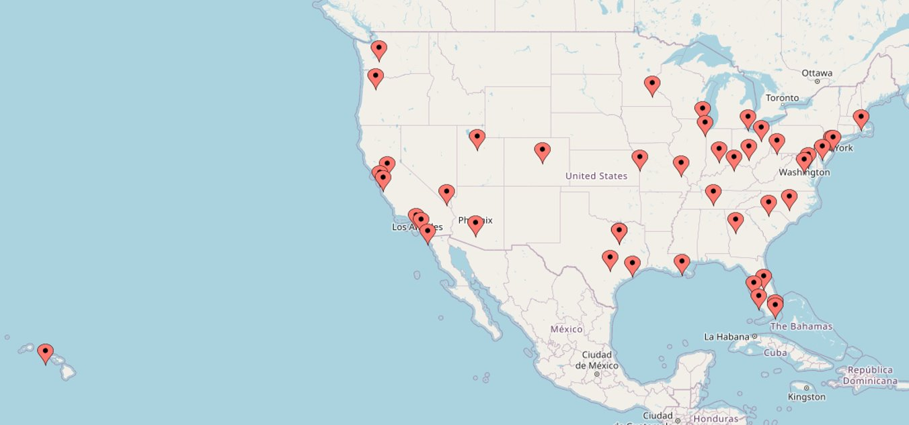
IST 707 – Data Analytics
Motivation
Flight delays and cancellations have several time and cost implications for passengers worldwide.
Project Goal
Gain insights from airline travel data to better understand the chances of flight delays and cancellations
50 busiest US airports used in this analysis

Slide 5
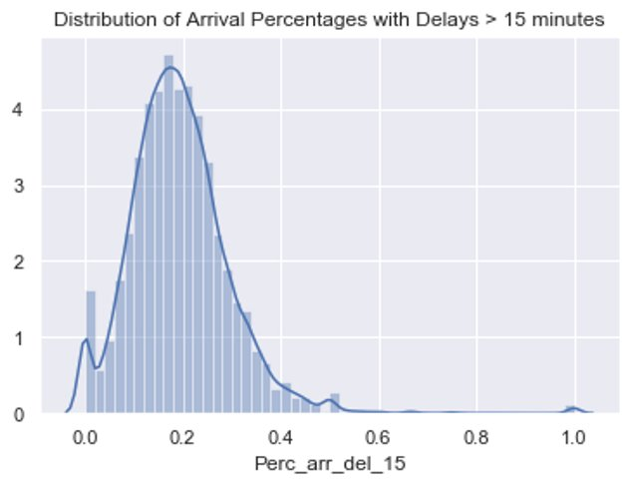
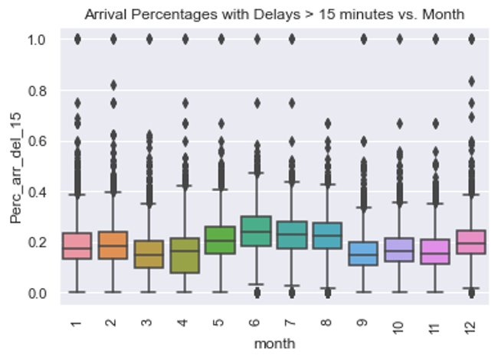
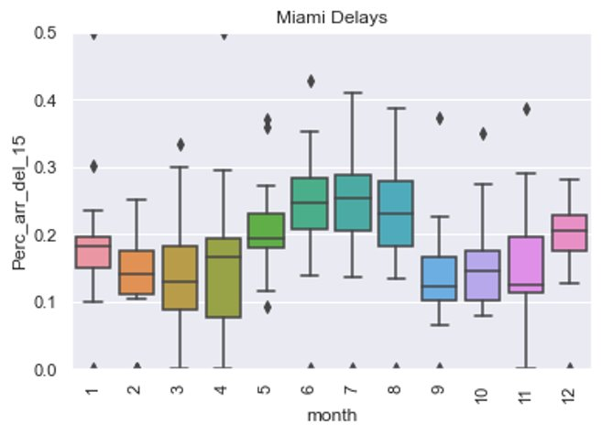

Slide 6
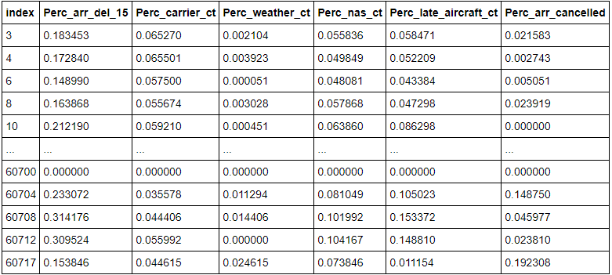
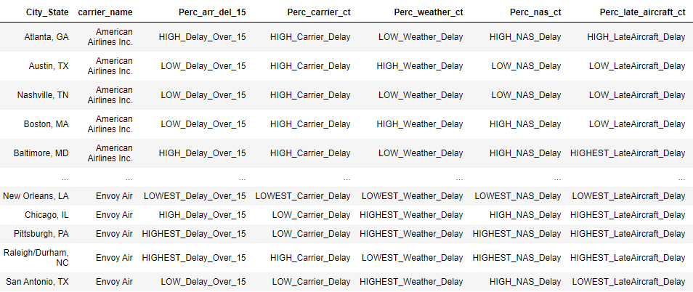
Flight Data Cleansing
Data after normalization for k-means clustering
Data after discretization for ARM

Slide 7
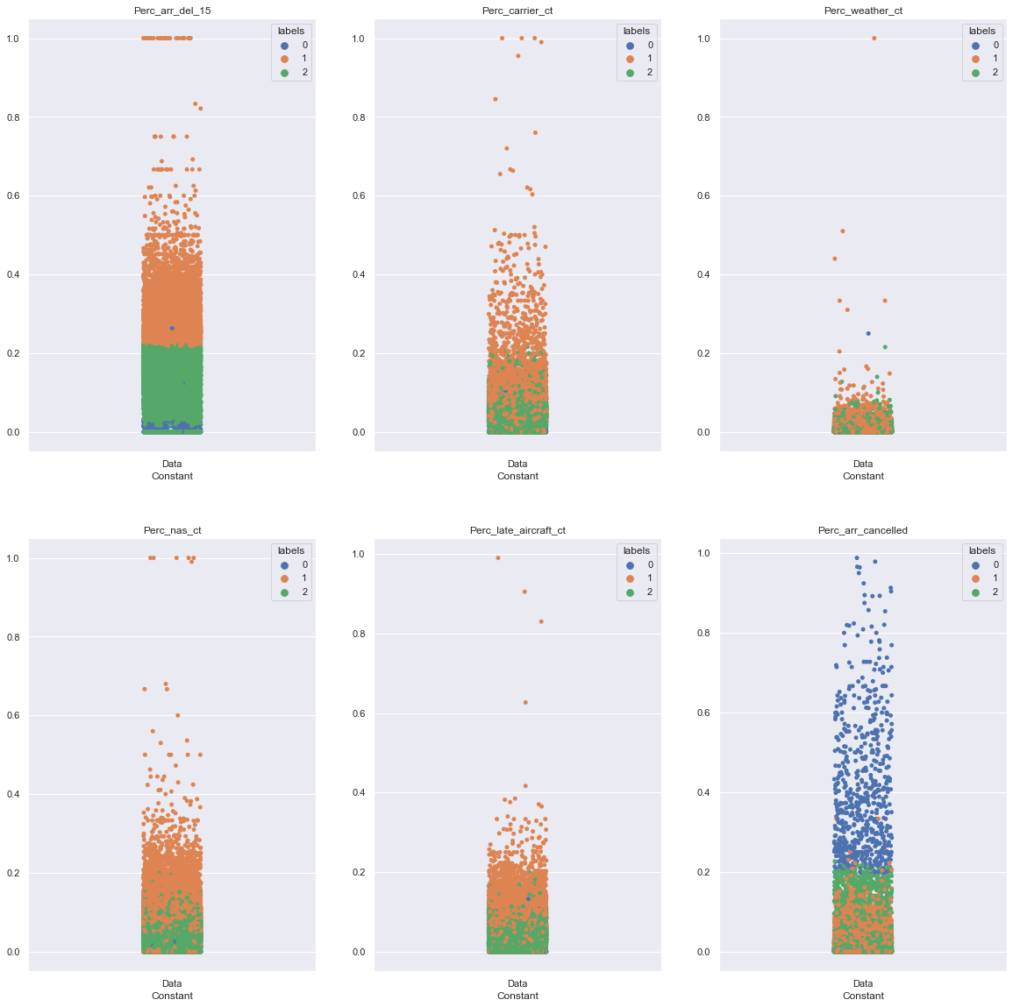
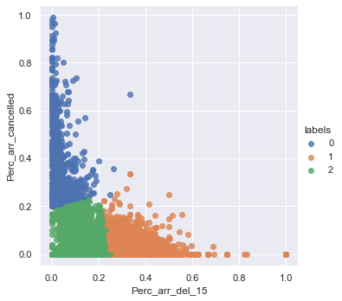
Flight Data Clustering Results
Two-dimensional scatterplot of K-means clustering results
K-means clustering results of the flight data for two different dimensions

Slide 8
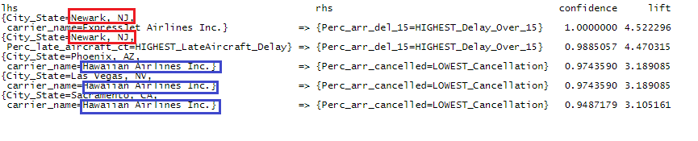
Flight Data ARM Results
ARM results for highest delays and cancellations

Slide 9
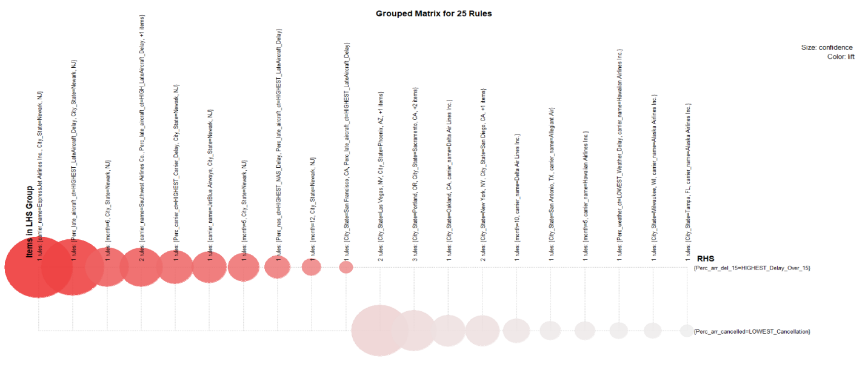
Flight Data ARM Results
Graphed ARM results for highest delays and cancellations

Slide 10
Flight Data – Linkage to Program Goals
Describe a broad overview of the major practice areas of data science.
Collect and organize data.
Develop alternative strategies based on the data.

Slide 11
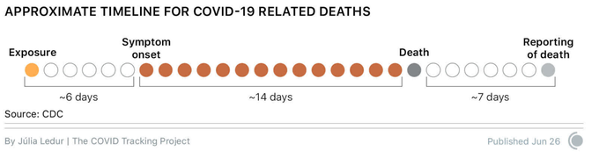
IST 718 – Big Data Analytics
Motivation
Covid-19 has created a global health crisis unlike any other in recent memory and understanding the virus can help society better respond, acclimate, and curb the negative effects of this ongoing crisis.
Project Goal
Create a time series model that predicts Covid-19 related deaths
Timeline of Covid-19 related deaths from exposure to the reporting of death

Slide 12
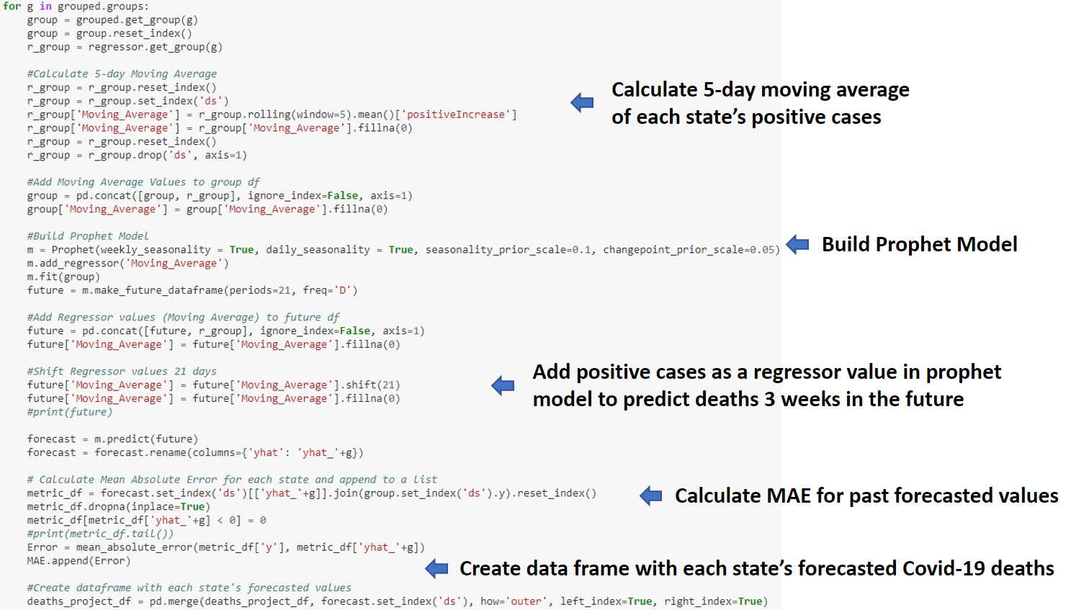
Predicting Covid-19 Deaths

Slide 13
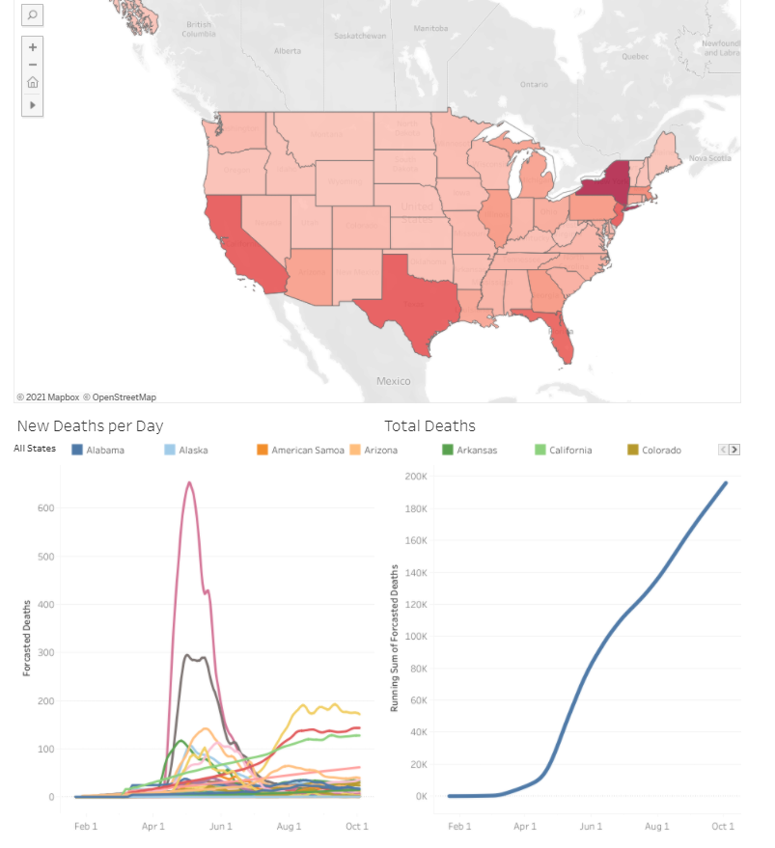
Predicting Covid-19 Deaths

Slide 14
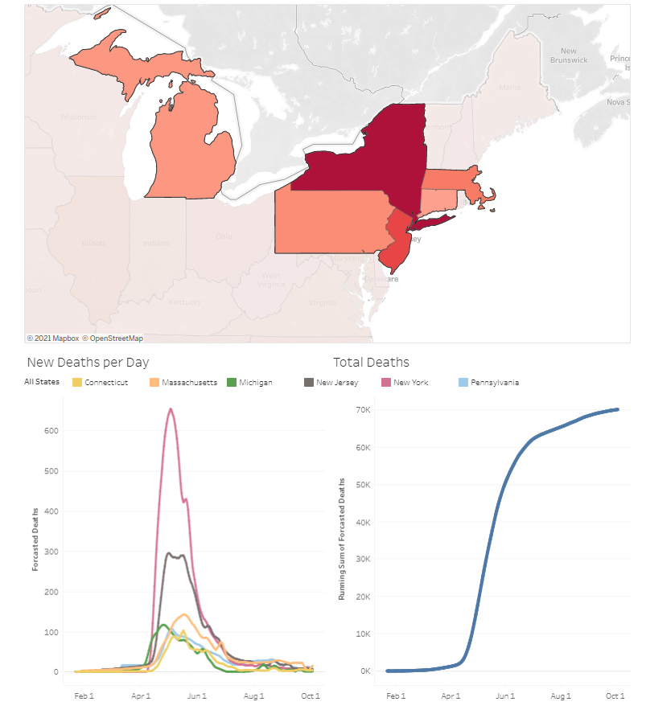
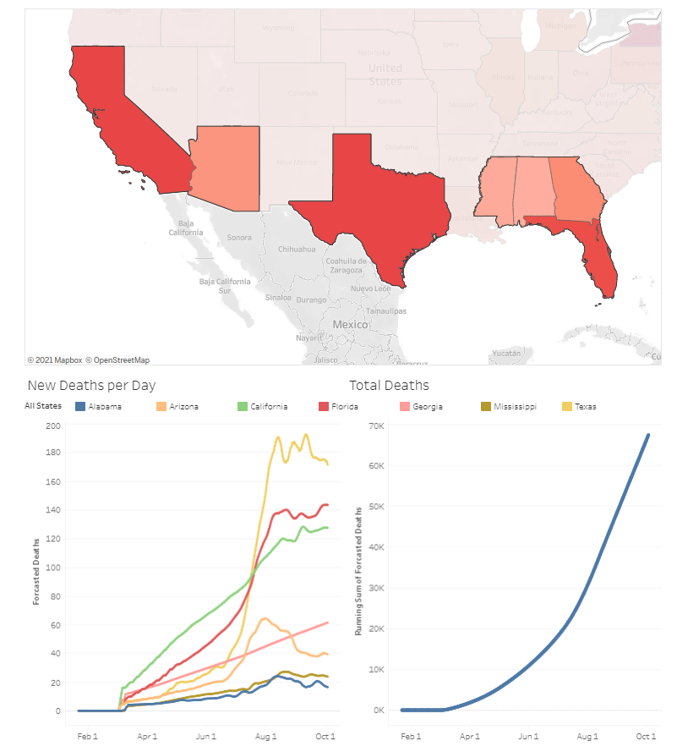
Predicting Covid-19 Deaths

Slide 15
Predicting Covid-19 Deaths – Linkage to Program Goals
Describe a broad overview of the major practice areas of data science.
Collect and organize data.
Identify patterns in data via visualization, statistical analysis, and data mining.
Develop a plan of action to implement the business decisions derived from the analyses.
Demonstrate communication skills regarding data and its analysis for managers, IT professionals, programmers, statisticians, and other relevant professionals in their organization.

Slide 16
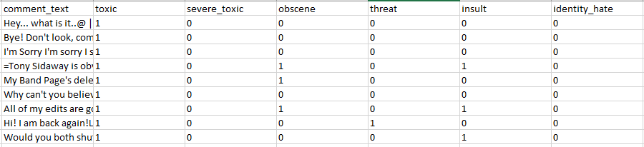
IST 652 – Scripting for Data Analysis
Motivation
Offensive and vulgar language have plagued internet communities since its inception. When considering the massive scale in which humans are interacting and communicating with each other on the web, it is nearly impossible to censor toxic comments through manual human labor.
Project Goal
Create a neural network model to identify and classify text data based on its toxcity
Sample of data from the Toxic Comment Classification Challenge. Each comment has been scored by a human based on its toxicity.

Slide 17
Toxic Comments Neural Network Model Layers
Code snippet of LSTM model using the defined layers
Embedding: Important for natural language processing as it helps reduces the dimensionality of discrete variables
LSTM: Adds sequence-prediction and neural-network capabilities
GlobalMaxPool: Reduces over-fitting
Dense: A dense layer is a fully connected layer where each 'neuron' is connected to all other variables from the next layer.

Slide 18
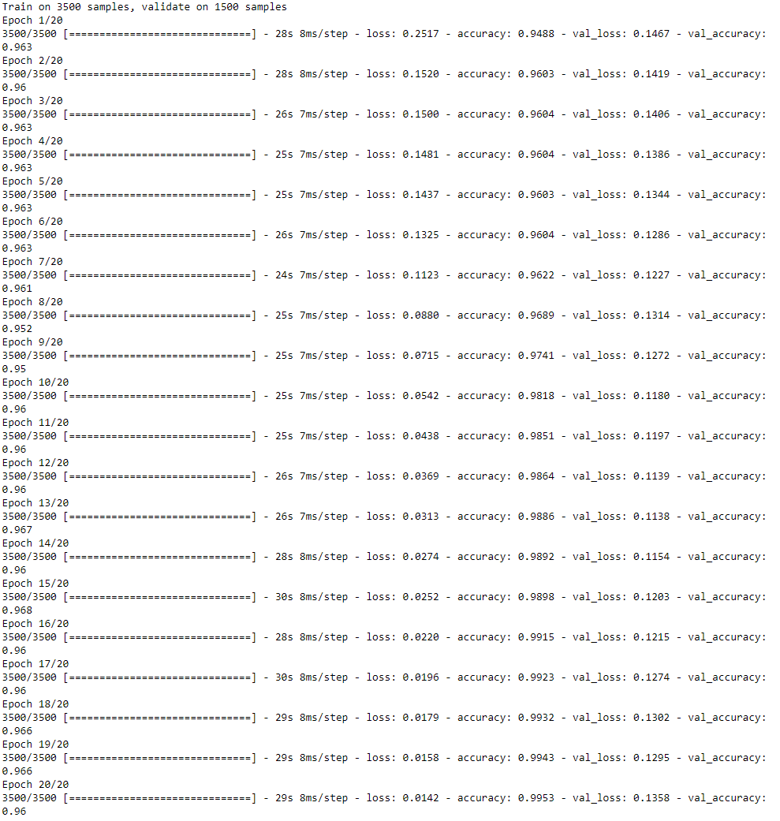
Toxic Comments Neural Network Model Results

Slide 19
Toxic Comments Neural Network – Linkage to Program Goals
Identify patterns in data via visualization, statistical analysis, and data mining.

Slide 20
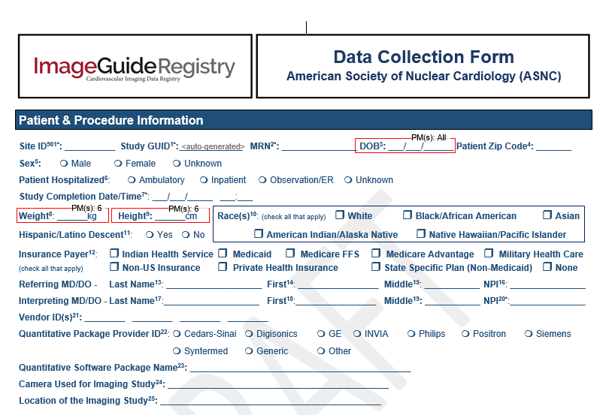
IST 659 – Data Admin Concepts & Database Management
Motivation
Quality improvement opportunities in healthcare are often found from analysing data stored in clinical data registries. This registry data can answer specific questions with the goal of providing better treatment for patients.
Project Goal
Design a database to store medical data focused on nuclear cardiology.
Sample of medical report form

Slide 21
Protected Health Information
Names (Full or last name and initial)
Dates (other than year) directly related to an individual
Phone Numbers
Email addresses
Social Security numbers
Medical record numbers
Health insurance beneficiary numbers
Account numbers
Certificate/license numbers
Vehicle identifiers (including serial numbers and license plate numbers)
Device identifiers and serial numbers;
Biometric identifiers, including finger, retinal and voice prints
Full face photographic images and any comparable images

Slide 22
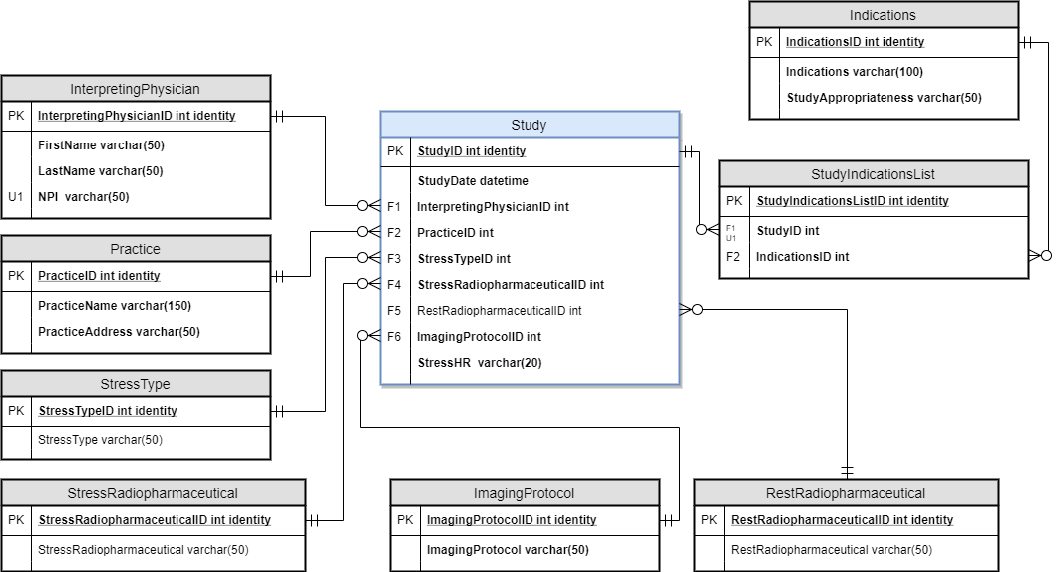
Nuclear Cardiology Database
Database entity relationship diagram for a nuclear cardiology data registry

Slide 23
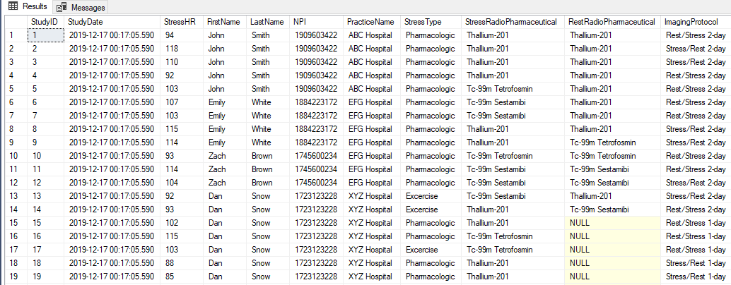
Nuclear Cardiology Database
Sample of SQL database with de-identified medical record data

Slide 24
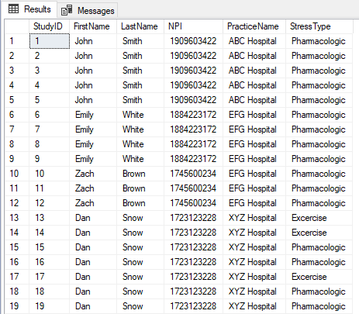
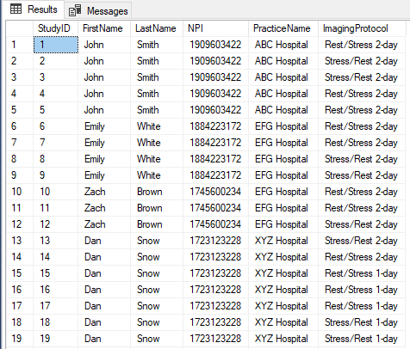
Nuclear Cardiology Database
Sample of SQL database with de-identified medical record data

Slide 25
Nuclear Cardiology Database – Linkage to Learning Outcomes
Demonstrate communication skills regarding data and its analysis for managers, IT professionals, programmers, statisticians, and other relevant professionals in their organization.
Synthesize the ethical dimensions of data science practice (e.g., privacy).

